Slide 1


SIT-ICOE
Hackathon’24
CRYPTO CODERS

Slide 2





OUR TEAM
01
02
03
SOUMYO NATH TRIPATHY
SHUBHAM KUMAR SINGH
PRAJAK SEN
04
05
AAYUSH KUMAR SINGH
UJJWAL KUMAR

Slide 3
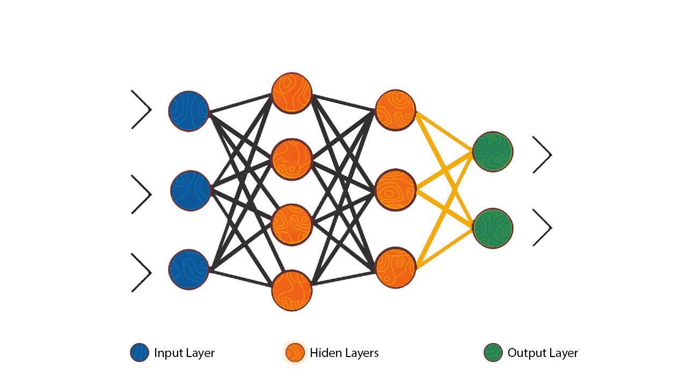
Introduction
Automated Essay Grading (AEG) systems have garnered significant attention in recent years due to their potential to alleviate the burden on educators and provide rapid feedback to students. However, existing AEG systems often lack transparency and interpretability, leaving students and educators with little understanding of how essays are graded. The goal of this project is to develop an AI model that not only grades essays but also provides explanations for the score, enhancing transparency and facilitating learning.
Automated Essay Grading (AEG) systems have been developed to streamline the process of evaluating student essays, particularly in large-scale educational settings. These systems leverage natural language processing (NLP) and machine learning techniques to assess the quality of essays based on various criteria such as coherence, organization, and language proficiency. While AEG systems offer many benefits, including efficiency and scalability, they often lack transparency and interpretability. This lack of transparency can be problematic for both educators and students, as it hinders their ability to understand how essays are evaluated and to provide actionable feedback for improvement.

Slide 4
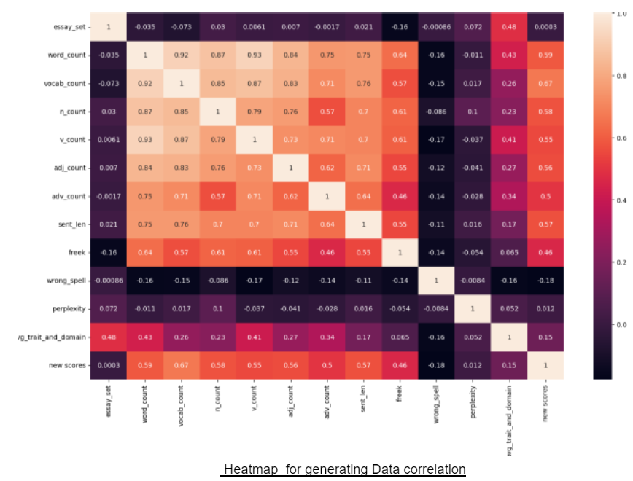
Data Preprocessing and Feature Engineering
1. Word Count Feature
2. Vocabulary Size Feature
3. Part-of-Speech (POS) Tagging Feature
4. Sentence Length Feature
5. Bag of Words (BOW) Feature
6. Frequent Words Feature
7. Spell Check Feature
8. Essay Perplexity Feature
9. Data Storage

Slide 5
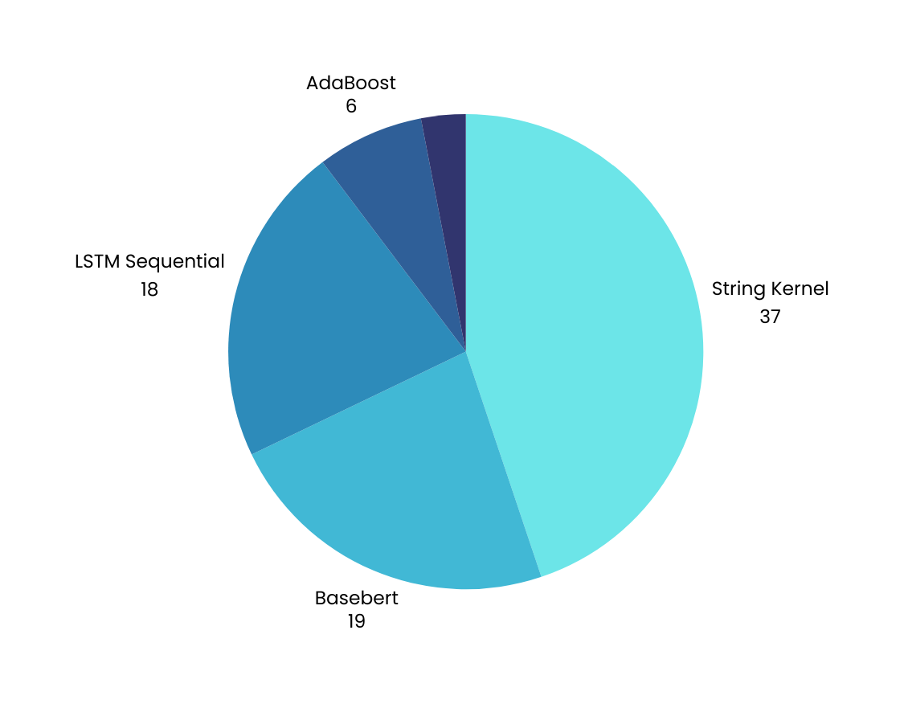
Our Proposed Model
A 2-layer LSTM model is defined using Keras. It consists of two LSTM layers followed by a dropout layer and a dense layer.
Relu activation is used in the output layer since the scores are not normalized.
Mean squared error is used as the loss function, and RMSprop is used as the optimizer.

Slide 6

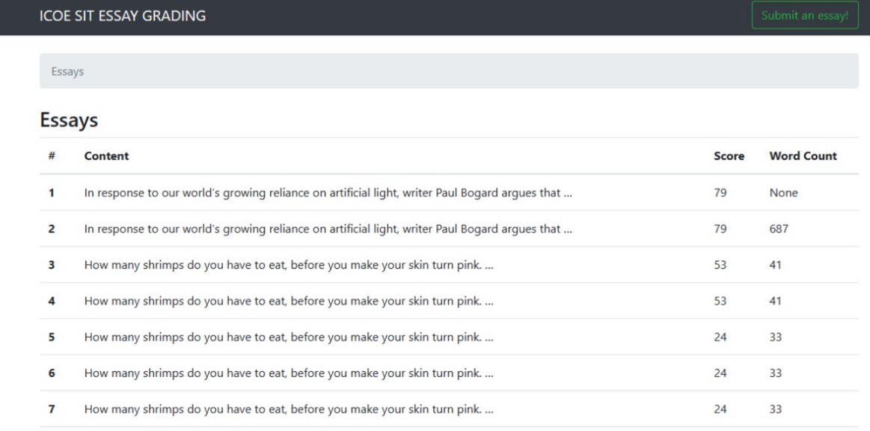
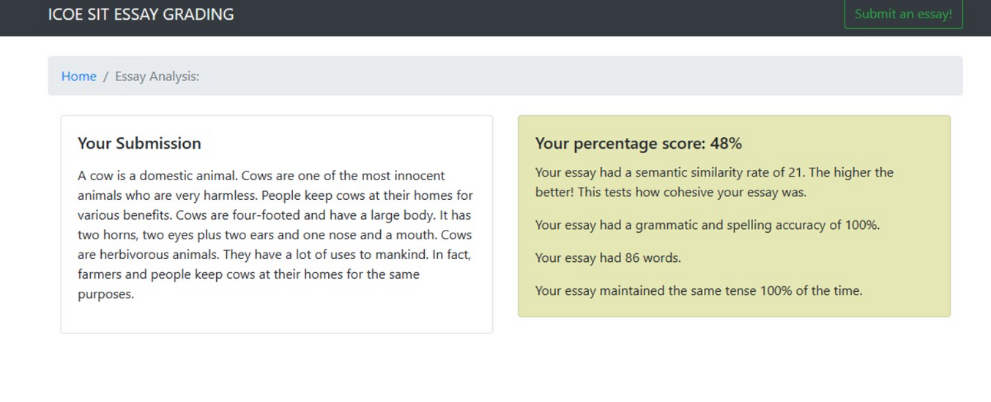
OUR PROJECT AS END TO END APPLICATION
1. Improved Text Representation
2. Enhanced Language Analysis
3. User-Friendly Interface

Slide 7
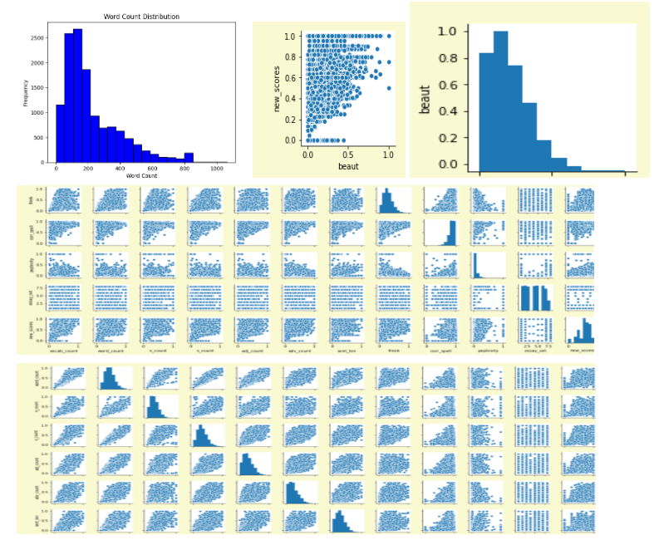
Data Preprocessing
In preprocessing the data, we initially calculate the average scores for traits 1, 2, and 3, as well as for the domain attributes, which are then added as new features to the dataset. Subsequently, we construct a new dataset by selecting pertinent attributes from the original data and incorporating the calculated averages. This amalgamated dataset serves as the foundation for further analysis. Finally, to streamline the dataset and focus on key attributes, we eliminate redundant columns such as the domain scores and individual trait averages. This streamlined dataset is then ready for subsequent analysis and modeling, enabling a more focused and effective approach to grading and assessment.

Slide 8
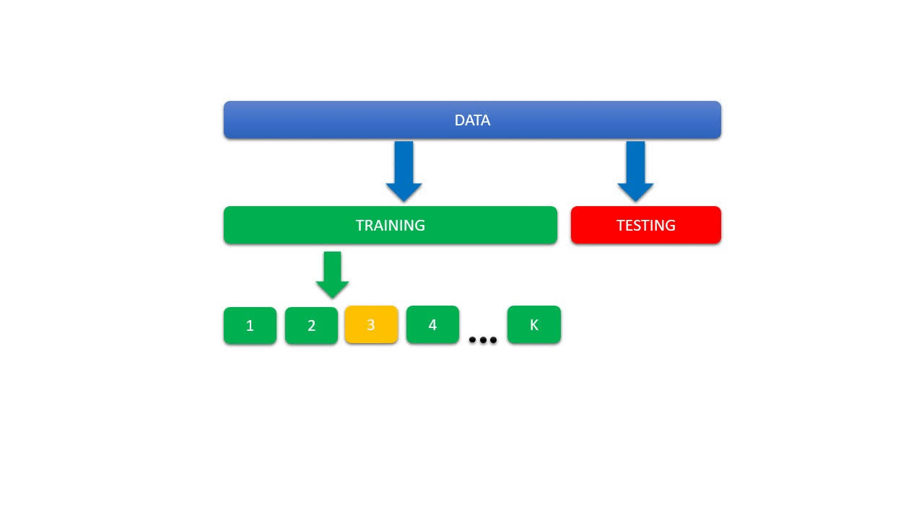
K-Fold Cross Validation
K-Fold Cross Validation is a technique used to assess the performance and generalization ability of machine learning models. It involves splitting the dataset into K subsets (or "folds") and training the model K times, each time using K-1 folds for training and the remaining fold for validation.
Importance: Cross-validation helps in estimating the model's performance on unseen data and reduces the risk of overfitting. It provides a more reliable assessment of how well the model will generalize to new data.

Slide 9
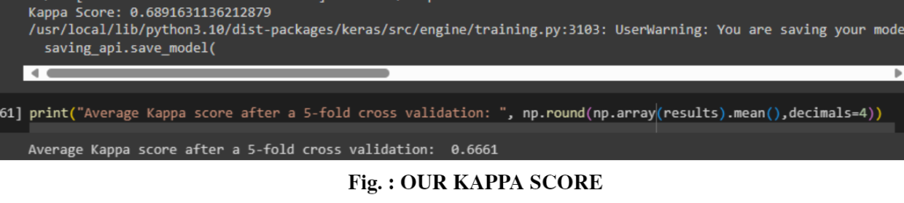
Cohen's Kappa
Definition:
Explanation:
Cohen's Kappa is a statistical measure of inter-rater agreement that takes into account the possibility of agreement occurring by chance. It provides a measure of the agreement between two raters (or in this case, human graders and the AI model) that is corrected for chance.
In automated essay grading, Cohen's Kappa is used to quantify the level of agreement between the scores assigned by human graders and those predicted by the AI model. It helps assess the reliability and consistency of the grading process.

Slide 10
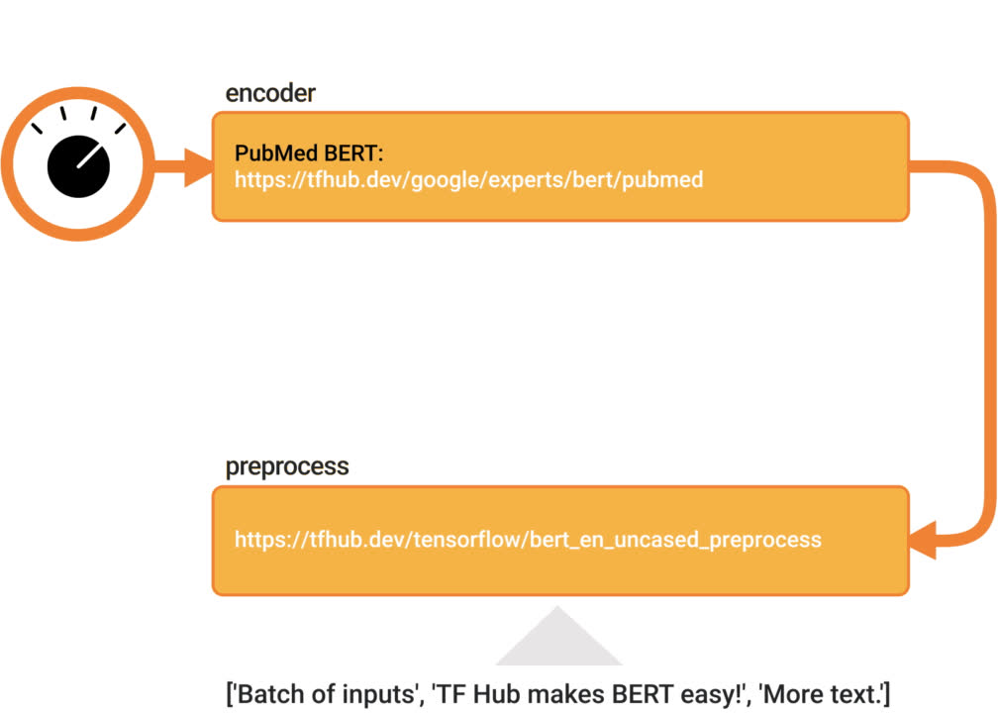
BASEBERT
Introduction: BASEBERT is an advanced model for automated essay scoring that leverages bidirectional attention-based sentence embeddings. It builds upon the BERT (Bidirectional Encoder Representations from Transformers) model architecture, enhancing its ability to capture contextual information and semantic meaning in essays.
Explanation: BASEBERT improves essay grading by better understanding the relationships between different parts of the essay and the prompts. It can analyze essays more comprehensively, leading to more accurate and nuanced scoring.

Slide 11
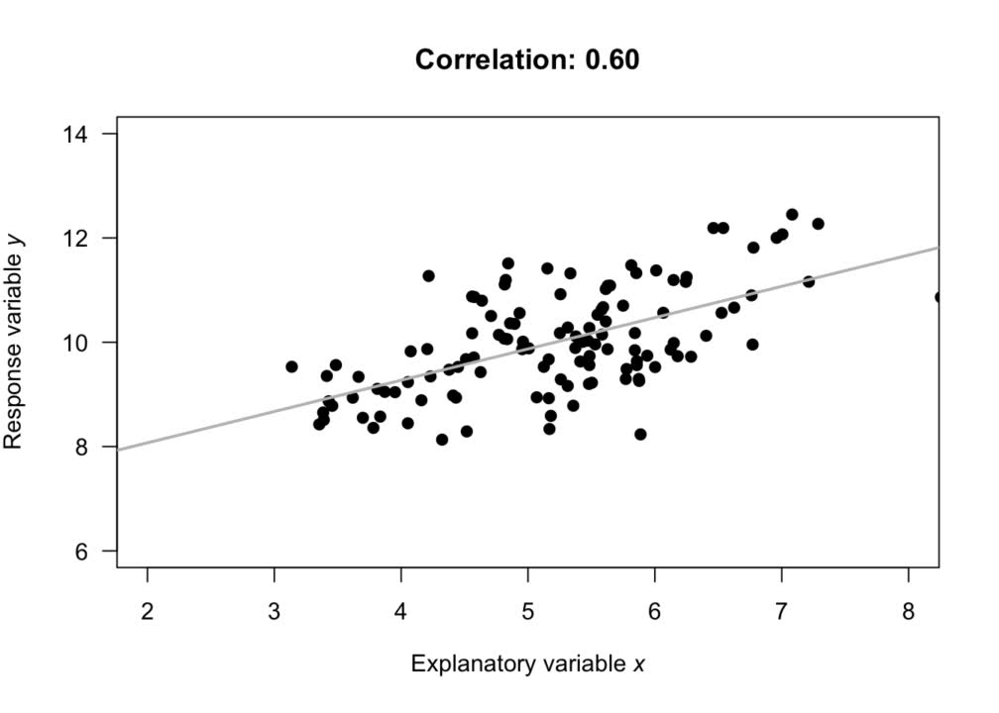
Pearson Coefficient
Definition: The Pearson Coefficient, also known as Pearson correlation coefficient, measures the strength and direction of the linear relationship between two variables. It ranges from -1 to +1, where +1 indicates a perfect positive linear relationship, -1 indicates a perfect negative linear relationship, and 0 indicates no linear relationship.
Explanation: In automated essay grading, the Pearson Coefficient is used to assess the correlation between the predicted scores generated by the AI model and the scores assigned by human graders. It provides insights into how well the model's predictions align with human judgment.

Slide 12
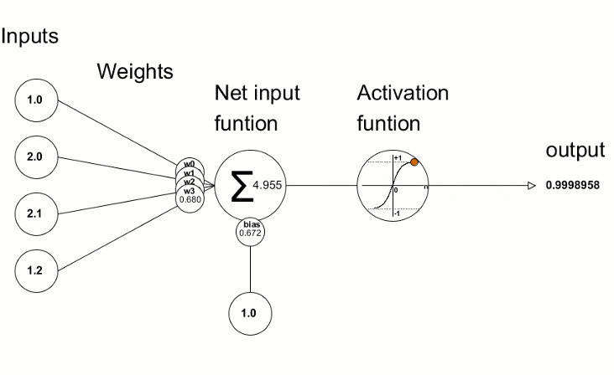
ReLU Propagation
Explanation
Importance:
01
02
ReLU (Rectified Linear Unit) is an activation function commonly used in neural networks. ReLU propagation refers to the process by which ReLU activation functions propagate through the layers of a neural network during forward and backward passes
ReLU activation function helps in overcoming the vanishing gradient problem, allowing for more efficient gradient propagation during training. This results in faster convergence and improved training of deep learning models.

Slide 13
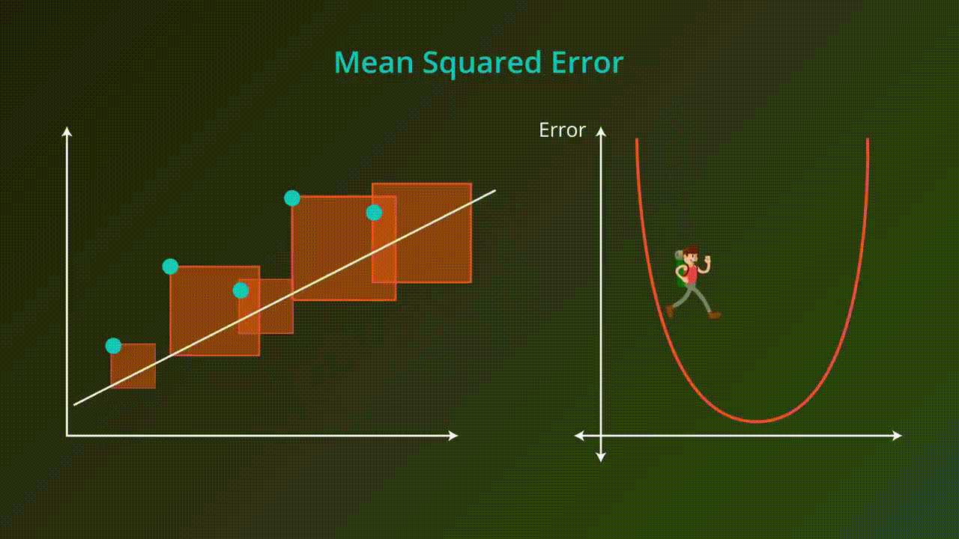
Mean Squared Error (MSE)
Explanation:
Mean Squared Error (MSE) is a common metric used to measure the average squared difference between the predicted values and the actual values in a regression problem. It quantifies the average magnitude of errors produced by the model.
Importance:
MSE provides insight into how well the model's predictions align with the actual values, with lower MSE indicating better model performance.

Slide 14
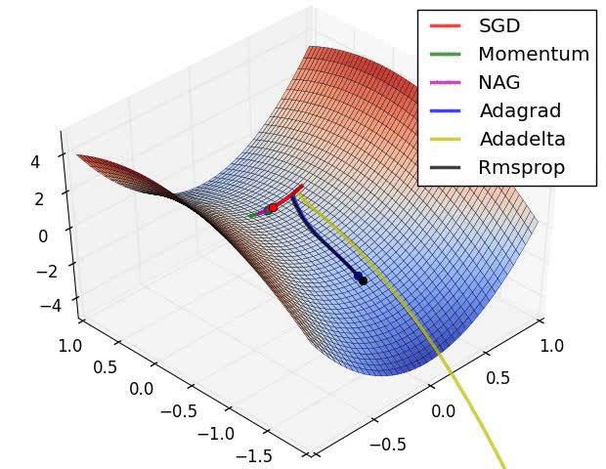
Adam's Optimizer
Explanation:
Features:
Adam's Optimizer adjusts the learning rate for each parameter individually based on the magnitude of its gradients. This adaptive learning rate scheme allows the optimizer to dynamically adapt to the characteristics of each parameter, leading to more efficient optimization.
Adam's Optimizer is a popular optimization algorithm used in training deep learning models. It combines the benefits of both adaptive gradient descent algorithms and momentum methods to efficiently update model parameters during training.
Advantages
Adam's Optimizer typically converges faster than traditional optimization algorithms due to its adaptive learning rate scheme and momentum-based updates. This accelerated convergence reduces the time required for model training, making it suitable for large-scale deep learning tasks.

Slide 15
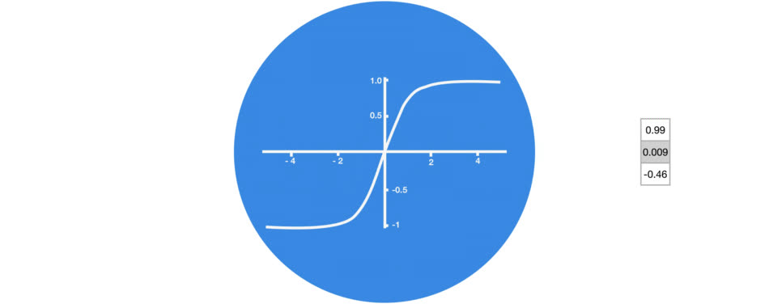
Loss Function
Explanation:
A loss function measures how well the model's predictions match the actual target values during training. It quantifies the difference between predicted and actual values and serves as the objective that the optimizer seeks to minimize.
Types of Loss Function
Mean Squared Error (MSE)
Cross-Entropy Loss
Importance
Choosing the Right Loss Function: Selecting an appropriate loss function is crucial as it directly impacts the optimization process and the performance of the trained model. Different loss functions are suited for different types of tasks and model architectures.

Slide 16
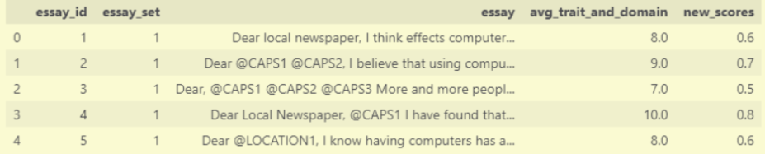
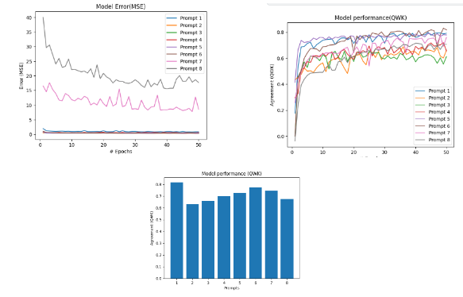
Results and Analysis
Performance Metrics:
Explainability Analysis:
In assessing the explainability of our automated essay grading system, we first examine the model architecture and parameters, such as embedding dimension, hidden dimension, and number of epochs, which define its structure and complexity. Additionally, the loss function, represented by the Mean Squared Error (MSE) in our case, provides insight into how the model optimizes its parameters during training. By understanding these components, stakeholders can gain clarity on how the model processes and evaluates essay data. Furthermore, visualization techniques, such as graphs displaying agreement (Quantified Weighted Kappa, QWK) and error (MSE) over epochs, offer transparency into the model's performance and the validation process. Through these explainability metrics, we aim to enhance transparency and understanding of our automated essay grading system's inner workings.

Slide 17

Thank You
SLIDE PRESENTATIONS DESIGN

